Slide 1
Operating Systems
CE206
Ruchika Patil
Assistant Professor,
Computer department
SPIT

Slide 2
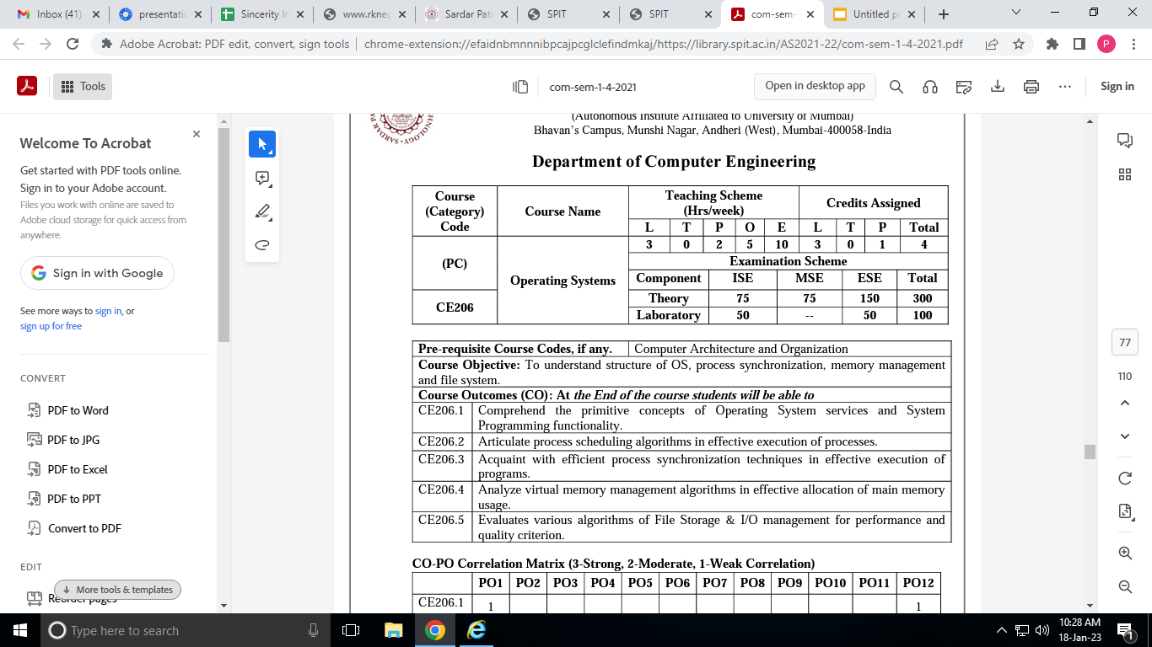
CREDITS

Slide 3
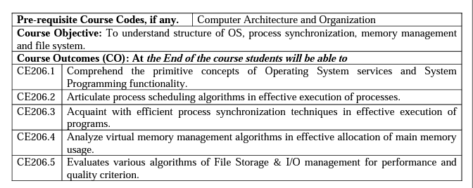
Course Outcomes (CO)

Slide 4
Books
System Programming by D M Dhamdhere
System Programming by John Donovan
Operating System Concepts by Abraham Silberschatz, Peter B Galvin, Greg Gagne
Operating Systems: Internals and Design Principles by William Stallings
Modern Operating Systems by Andrew S. Tanenbaum, Herbert Bos
Design of the UNIX Operating Systems by Maurice J. Bach

Slide 5
Introduction to System Software and
Operating Systems

Slide 6
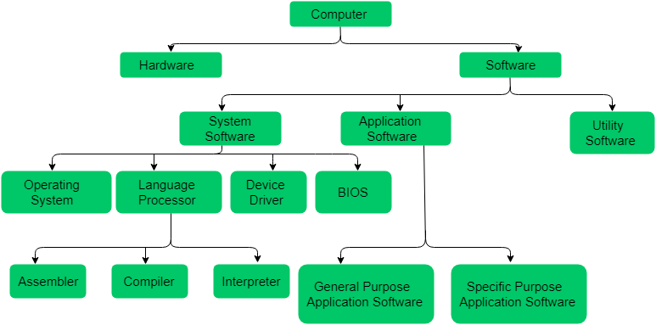

Slide 7
Software
Computer software, or just software, is a general term primarily used for set of instructions such as computer programs and other kinds of information read and written by computers.

Slide 8
System Softwares:
System softwares is a set of program that manages the resources of computer system.
Acts as the computer hardware and application software interface.
Provides platform to other softwares.
The end-user usually does not directly communicate with the system software; instead, the user interacts with the user interface created by the system software.
Programs written in low level language.
General Purpose Software
Examples: Operating systems, Utilities- BIOS, Device drivers

Slide 9
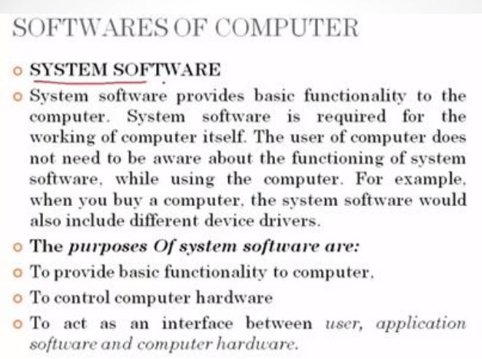

Slide 10
System softwares can be broadly classified into:
System control programs
controls the execution of programs,
manage the storage & processing resources of the computer & perform other management & monitoring function.
System support programs
provide routine service functions to the other computer programs & computer users
Eg. libraries, performance monitors & job accounting.

Slide 11
Application Software:
Application software is a program that performs a specific task for the end user.
It runs on the platform provided by system software.
It acts as a platform between the system software and the end user.
Word-processing, Spreadsheet, Database, etc.

Slide 12
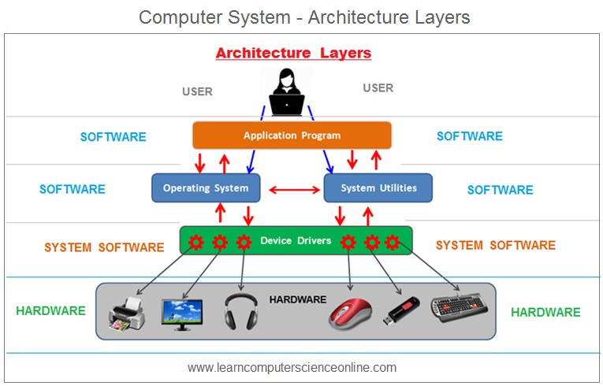

Slide 13
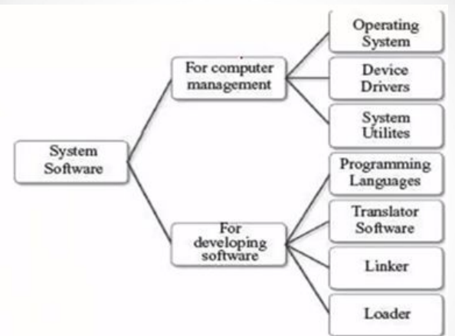

Slide 14
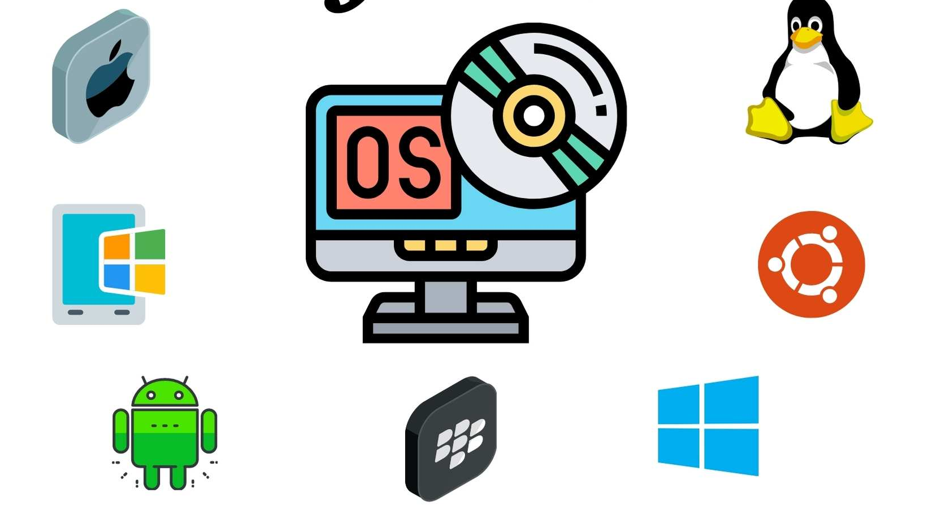
Operating System:
A program that acts as an intermediary between a user of a computer and the computer hardware

Slide 15
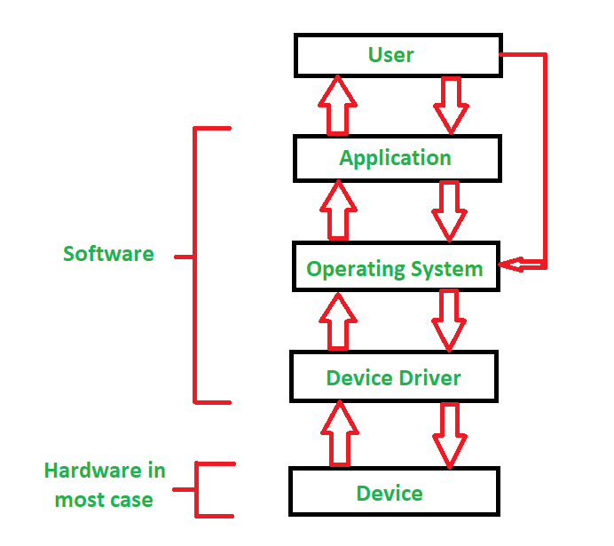
Device Drivers:
Device Driver in computing refers to a special kind of software program or a specific type of software application that controls a specific hardware device that enables different hardware devices to communicate with the computer’s Operating System

Slide 16
System utilities
The Utility Software is system software that helps to maintain the proper and smooth functioning of a Computer System
Assists the Operating System to manage, organize, maintain, and optimize the functioning of the computer system.
EXAMPLES: Antivirus software, file management tools, data compression tools, disk management tools, disk cleaners, network managers etc.

Slide 17
System Programming

Slide 18
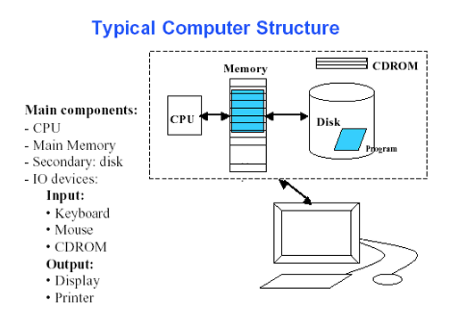

Slide 19
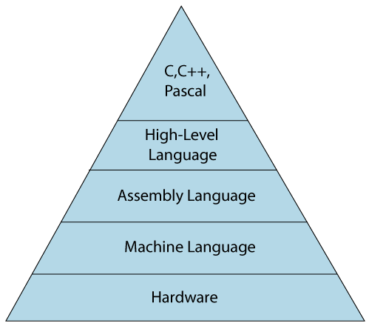
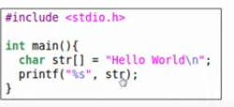
Programming Language
A programming language defines a set of instructions that are compiled together to perform a specific task by the CPU (Central Processing Unit).
https://www.javatpoint.com/classification-of-programming-languages

Slide 20
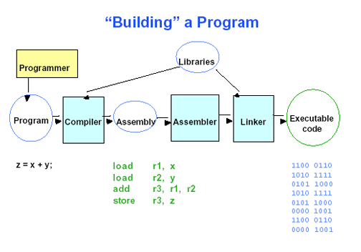

Slide 21
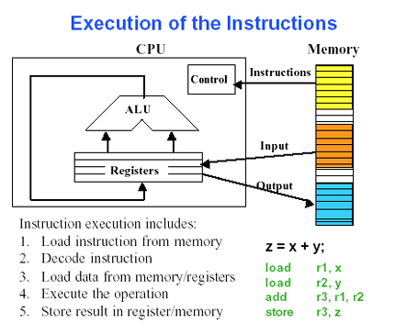

Slide 22
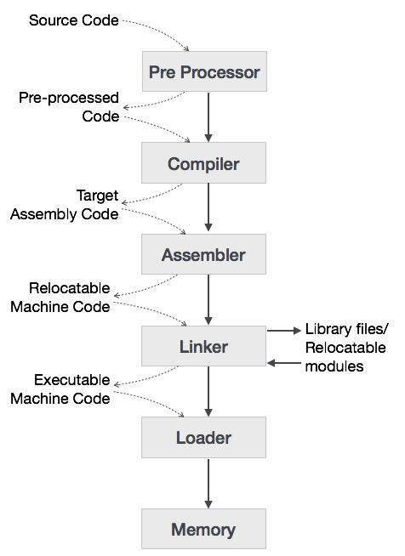
Object code
Executable file

Slide 23
Preprocessor
A preprocessor, generally considered as a part of compiler, is a tool that produces input for compilers. It deals with macro-processing, augmentation, file inclusion, language extension, etc.

Slide 24
Softwares of Computer
Translator Software:
Used to convert a program written in high level language/assembly to a form that machines can understand.
The translated program is called Object code
Three kinds of Translator software:
Assembler
Compiler
Interpreter

Slide 25
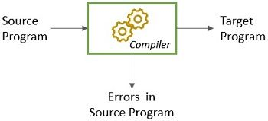
Compiler
A compiler is a program that converts high-level language to assembly language.
Specifies the error at the end of compilation with line numbers

Slide 26
Interpreter
Translates high-level language into low-level machine language.
A compiler reads the whole source code at once, creates tokens, checks semantics, generates intermediate code, executes the whole program and may involve many passes. In contrast, an interpreter reads a statement from the input, converts it to an intermediate code, executes it, then takes the next statement in sequence.

Slide 27
Interpreter
If an error occurs, an interpreter stops execution and reports it. whereas a compiler reads the whole program even if it encounters several errors.

Slide 28
Assembler
An assembler translates assembly language programs into machine code.
The output of an assembler is called an object file, which contains a combination of machine instructions as well as the data required to place these instructions in memory.

Slide 29
Linker
Linker is a computer program that links and merges various object files together in order to make an executable file.
The major task of a linker is to search and locate referenced module/routines in a program and to determine the memory location where these codes will be loaded, making the program instruction to have absolute references.
Produces .exe file

Slide 30
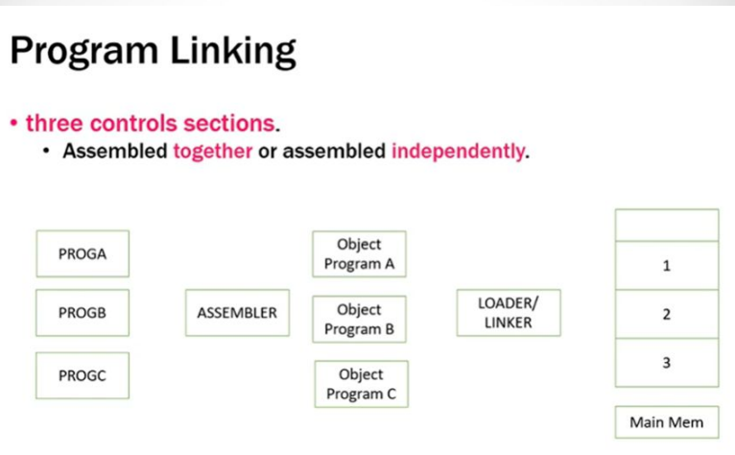

Slide 31
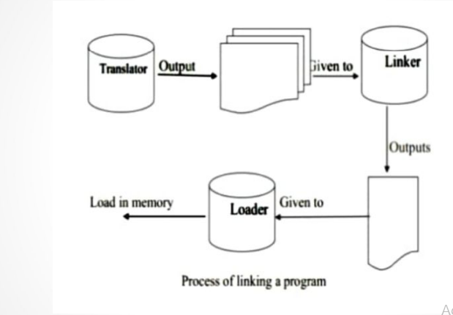

Slide 32
Types of linking:
1. Static Linking –
It is performed during the compilation of source program.
Linking is performed before execution in static linking.
It takes collection of relocatable object file and command-line arguments and generates a fully linked object file that can be loaded and run.

Slide 33
Types of linking:
2. Dynamic linking –
Dynamic linking is performed during the run time.
This linking is accomplished by placing the name of a shareable library in the executable image.
There are more chances of errors and failures.
It require less memory space as multiple programs can share a single copy of the library

Slide 34
Loaders:
Loader is utility program which takes object code as input prepares it for execution and loads the executable code into the memory. Thus loader is actually responsible for initiating the execution process.
The loader is responsible for the activities such as allocation, linking, relocation and loading

Slide 35
Functions of Loader:
1) It allocates the space for program in the memory, by calculating the size of the program. This activity is called allocation.
2) It resolves the symbolic references (code/data) between the object modules by assigning all the user subroutine and library subroutine addresses. This activity is called linking.

Slide 36
Functions of Loader:
3) There are some address dependent locations in the program, such address constants must be adjusted according to allocated space, such activity done by loader is called relocation.
4) Finally it places all the machine instructions and data of corresponding programs and subroutines into the memory. Thus program now becomes ready for execution, this activity is called loading.

Slide 37
Loader
Loader is a part of operating system and is responsible for loading executable files into memory and execute them.
It calculates the size of a program (instructions and data) and creates memory space for it. It initializes various registers to initiate execution.

Slide 38
